Slide 1
SEO CASE STUDY
A journey From 5k monthly users to 12k users

Slide 2

The Client
Shamunsflowers.com is a renowned online florist based in Pune. They have an e-commerce website in Shopify through which they run their retail business of flower bouquets. They design the best bouquets and have over 25+ years of experience in this field.
Campaign Objectives
The SEO campaign’s goal was to increase site traffic and generate local traffic to drive more sales. Also to increase their rank on primary keywords of category pages. After the approval of the client I optimized the pages by adding their primary keywords like: flower delivery in pune, online cake delivery pune.

Slide 3
Challenges
Preferred keywords needed to be ranked on the top search engine result pages.
Meta titles and tags needed to be added.
Schema markup was not implemented.
The website loading speed was very low.
Poor conversion due to landing page usability issues
A few page links were not indexed by any search engine.
Across the business directories, the business name, address, and phone number were not consistent.
Google analytics and Search console was not installed in the website, as a result, I didn’t had previous data of the website.

Slide 4
The Strategy
On-Page strategies:
SEO Site Auditing
Competitors Analysis
Keywords Research
On-Page SEO for every page
Canonicalization Issues Fix
Header Tags Optimization for Each Pages
Internal Link Optimization
Robots Tit Creation/Analysis
XML Sitemap/Analysis
Google Webmaster Tools Set Up and
optimization
Google Analytics Set Up and Analysis
Page Speed Optimization Analysis on Mobile and Desktop and fix as per search engine guidelines
404 issues solved
Google Analytics Conversion Setup
Alt tag images Optimization for all pages
Add a Schema Markup for Pages and Blogs
Fresh Blog suggestions for website that attract the target market
Title & Meta Tag Optimization
Image Optimisation
HTML Site Map Creation and optimization
Website usability analysis
Mobile and Desktop Speed Analysis
SEO-friendly URL Structure
Plagiarism Analysis
Place Important and LSI keywords in Content and Meta tags

Slide 5
The Strategy
Off-Page strategies:
Competitors Backlinks Building analysis
Theme based link building
Guest Posting/Blog Outreach
Quora Answers
Blog and Articles Posting and sharing Content Marketing
Forums Discussions, Web 2.0 Links
Remove toxic links
Create Infographics using canva
Profile creation to create visibility of website
Social bookmarking
Business Submission
Classified ads submission
Focused more on image submission
Infographic Submission

Slide 6
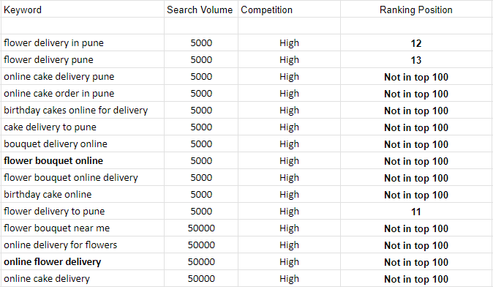
Campaign Results
Keyword ranking Before SEO:
Keywords- 15
Volume- 5000 and above
Competition- all high
Ranking- Not in 100 except
3 keywords

Slide 7
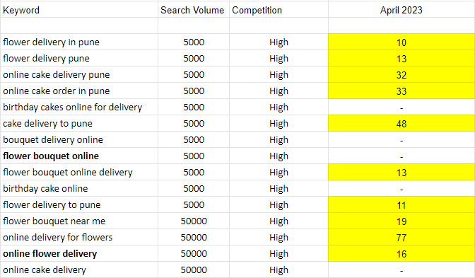
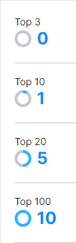
Campaign Results
Keyword ranking After I implemented SEO:

Slide 8
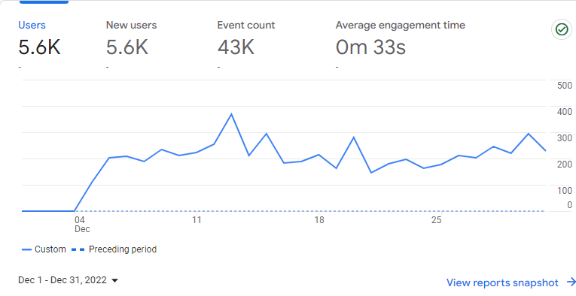
Campaign Results
Traffic Before SEO:
Users - 5.6k/month
New Users - 5.6k/month
Event count - 43k/month
Sessions - 6.2k/month
Views - 14k/month

Slide 9
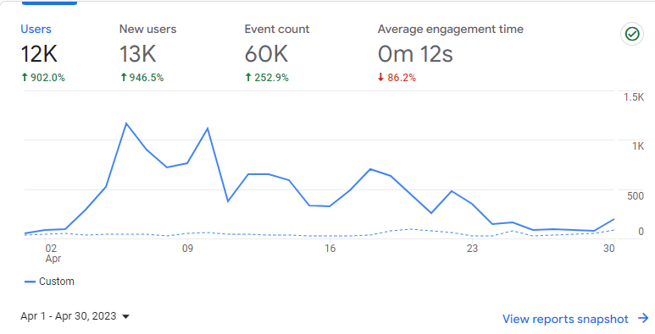
Campaign Results
Traffic After I implemented SEO: 4 Months of Work
Users - 12k/month
New Users - 13k/month
Event count - 60k/month
Sessions - 14k/month
Views - 23k/month

Slide 10
Thank You
I believe to provide best quality and services to the client with long term relationships.

